Slide 1
DATA STRUCTURES AND ALGORITHMS
FINAL PROJECT

Slide 2

TITLE
AMAZON PARCEL DELIVERY SYSYTEM
A Comprehensive Data Structures and Algorithms Project

Slide 3
PRESENTED BY
PARNIA AHMAD | SP24-BCS-084
ZAINAB AKHTER | SP24-BCS-099

Slide 4
INTRODUCTION
Objective: Build an efficient system to manage Amazon parcel deliveries using advanced
data structures and algorithms.
Context: Simulates Amazon’s logistics, handling parcels across cities like Lahore and Islamabad.
Dataset: amazon_delivery.csv with 100 parcels, including Order ID, Agent Age, Area,
Delivery Time, and Category.
Implementation: Written in C++ for scalability and performance.

Slide 5
DATA STRUCTURES OVERVIEW

Slide 6
Doubly Linked List: Stores parcels for easy traversal and deletion.
Queue: Manages parcels pending pickup (FIFO).
Stack: Tracks delivered parcels (LIFO).
Binary Search Tree (BST): Organizes parcels by delivery time for fastest delivery queries.
AVL Tree: Groups parcels by area with balanced searches.
Min-Heap: Prioritizes urgent parcels by delivery time.
Hash Table: Enables fast lookup by Order ID.
Graph: Models delivery areas with weighted edges for route optimization.

Slide 7
ATTRIBUTES USED
AGE
ORDER ID
PICKUP TIME
AREA
DELIVERY TIME
CATEGORY
VEHICLE
TRAFFIC

Slide 8
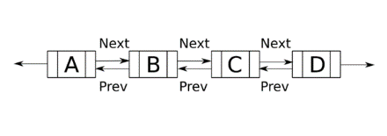
Doubly Linked List:
Stores parcel details (Order ID, Agent Age, Area, etc.).
Supports insertion, deletion, and bidirectional traversal.
Used for displaying all parcels and sorting by agent age.
Doubly Linked List, Queue, and Stack

Slide 9
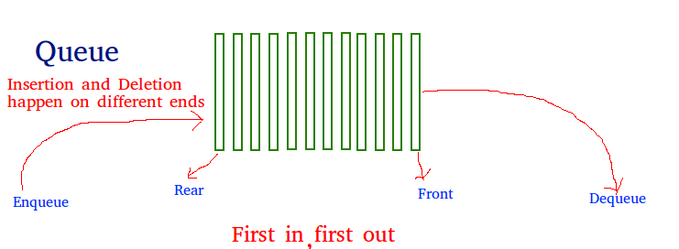
Queue: Enqueues parcels for pickup, dequeues for delivery. Stack: Pushes delivered parcels to track recent deliveries.

Slide 10
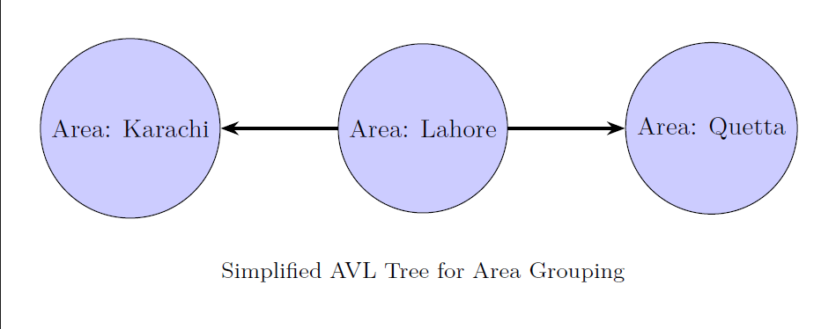
BST AND AVL
.
AVL Tree:
Groups parcels by area with self-balancing properties.
Ensures O(log n) search and insertion.
Displays parcels sorted by area.
Binary Search Tree (BST):
Organizes parcels by delivery time.
Finds fastest delivery by traversing to the leftmost node.

Slide 11
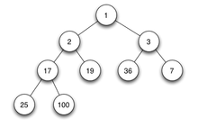
Min-Heap:
Prioritizes parcels with shortest delivery times.
Used to select urgent deliveries in pickupMostUrgentParcel().
Hash Table:
Maps Order IDs to parcels for O(1) average-case lookup.
Handles collisions using chaining.

Slide 12
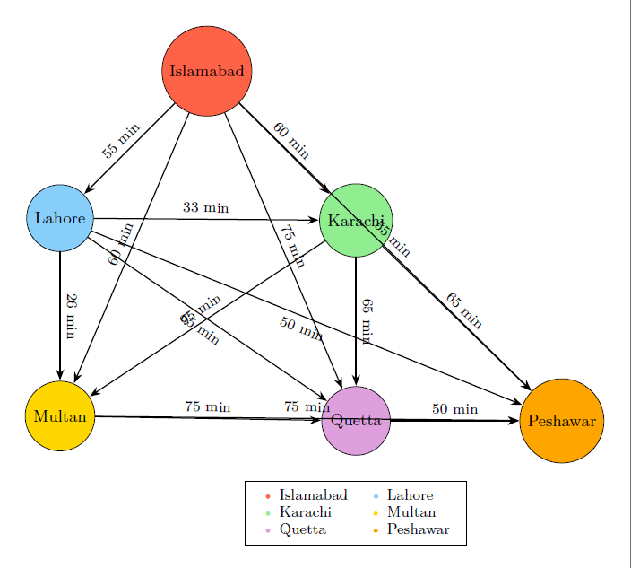
DELIVERY AREA GRAPH

Slide 13
Dijkstra’s Algorithm: Finds shortest paths from a source area.
Breadth-First Search (BFS) and Depth-First Search (DFS): Explores delivery routes.
Prim’s Algorithm: Connect all cities with minimum delivery time
Merge Sort: Sorts parcels by agent age.
Binary Search: Searches parcels by category after sorting.
KEY ALGORITHMS

Slide 14
Purpose: Computes shortest delivery paths (e.g., from Lahore to all areas).
Pseudocode:
Initialize distances: source = 0, others = infinity
Add source to priority queue
While queue not empty:
Extract minimum distance vertex u
For each neighbor v of u:
If distance[u] + weight(u,v) < distance[v]:
Update distance[v]
Update priority queue
Time Complexity: O((V + E) log V) with a priority queue.
DIJIKSTRA’S ALGORITHM

Slide 15
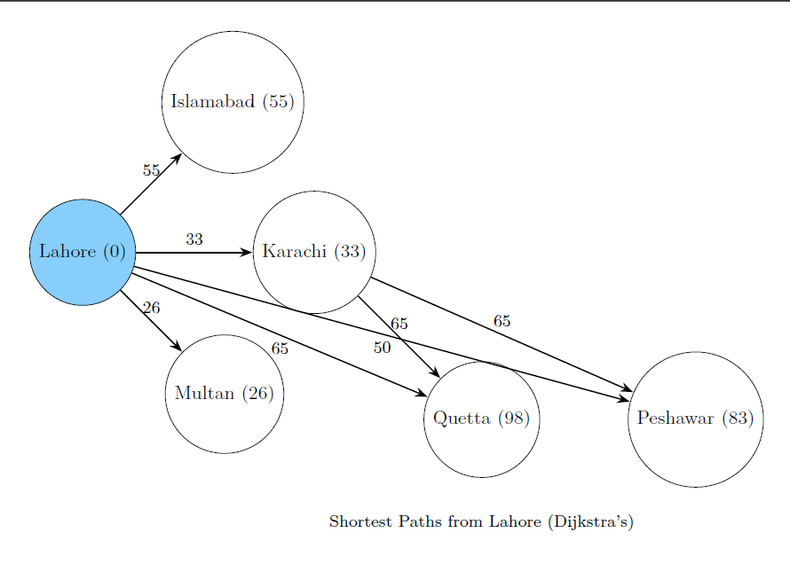
ROUTE OPTIMIZATION: (Dijkstra’s)

Slide 16
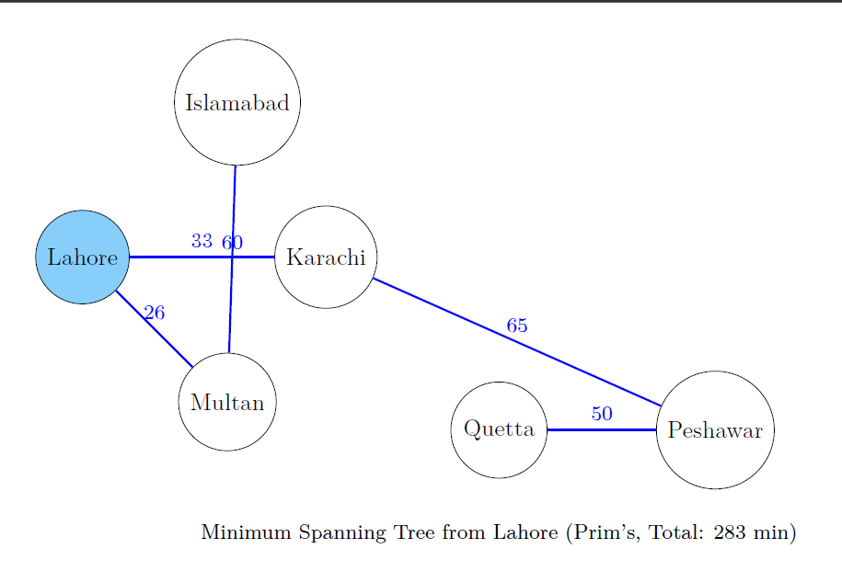
Prim’s MST from Lahore

Slide 17
--- Parcel Delivery System --- 1. Display all deliveries (doubly linked list ) 2. Enqueue parcel for pickup ( Queue ) 3. Pickup parcel (to deliver) ( Queue ) 4. View delivered parcels ( Stack ) 5. Delete long deliveries ( doubly linked list) 6. Search parcel by Order ID (linked list) 7. Show fastest delivered parcel (linked list) 8. Show fastest delivery by BST (binary search tree) 9. Display parcels grouped by Area (AVL Tree) 10. Pickup most urgent parcel (using heap) 11. Search parcel by category (binary search) 12. Sort parcels by Agent Age (Merge Sort) 13. Shortest path from a city (Dijkstra) 14. BFS and DFS on area graph 15. Search parcel using Hash Table (chaining) 16. Minimum Spanning Tree (Prim's Algorithm)
SYSTEM FUNCTIONALITIES

Slide 18
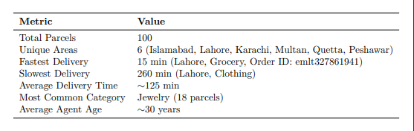
DATASET ANANLYSIS

Slide 19
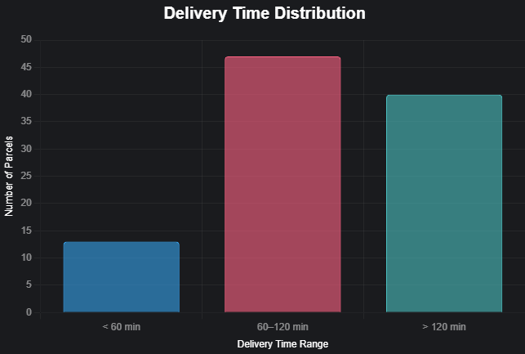
DELIVERY TIME DISTRIBUTION

Slide 20
Challenge: Handling large datasets efficiently.
Solution: Used Hash Table for O(1) lookups and AVL Tree for balanced searches.
Challenge: Normalizing area names (e.g., “lahore” vs. “Lahore”).
Solution: Implemented toTitleCase function for consistency.
Challenge: Building an accurate graph from parcel data.
Solution: Used minimum delivery times between areas as edge weights
CHALLENGES AND SOLUTIONS

Slide 21
Achievements: Built a robust system with diverse data structures for parcel management and route optimization.
Strengths: Scalable, fast searches, optimized delivery paths.
Applications: Suitable for real-world logistics like Amazon.
Future Enhancements:
Integrate real-time traffic data.
Develop a user-friendly GUI.
Support multiple vehicle types and dynamic routing. Thank You!
CONCLUSION

